Slide 1
NYC Crime 2006-TodaY
Melodie Vines
Rachael Songalewski
Alexandra Taft

Slide 2
Motivation and Summary
Why Crime Data?
Why NYC?
NYPD Methodologies
Current events and shooting data

Slide 3
Hypothesis
Null Hypothesis
Policing methodologies have no impact on shooting rates.
Alternate Hypothesis
Community or intelligence led policing methodologies decrease shooting rates vs other types of methods.

Slide 4
Questions
How has their policing approach changed over time? Did they combine methodologies during the period evaluated?
Where are shootings most prevalent in New York (analyzed by borough or precinct)?
What are the demographics of victims? Are there patterns or trends based on victim demographics?
What outliers were discovered in the data that had an impact on the crime rate? Are there geographical impacts?
How were shooting incidents statistically impacted by implemented strategies? What were those % changes (+/-)?

Slide 5
Specific Methodology Targets
We collectively reviewed multiple research studies to get our year groupings of interest:
2006 - 2010 - NYC was primarily utilizing their ComStat Model - baseline
2010 - 2014 – NYC was primarily utilizing their ComStat Model – with introduction of some community programs (Ceasefire, etc)
2015 - 2019 – Introduction of additional community policing initiatives

Slide 6
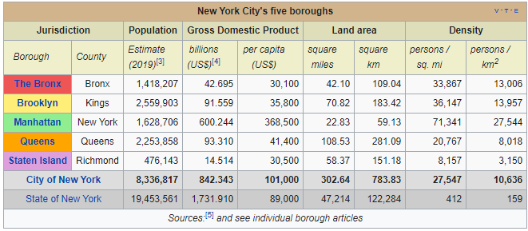
Data Sets
NYC Open Data
Historic Shooting CSV – 2006 – 2019
Borough Map
Shooting Data 2020 (January – June)
Methodology Years – per our research

Slide 7
Data Cleansing
Original Data
Data very clean with very few missing values so limiting cleansing required
Missing data on offenders
2020 Data
To answer additional questions we had about 2019 we populated 2020 months July – December total incident count with “0” so we could draw/ compare conclusions over the first 6 months.

Slide 8
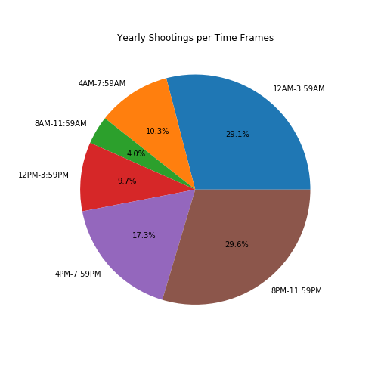
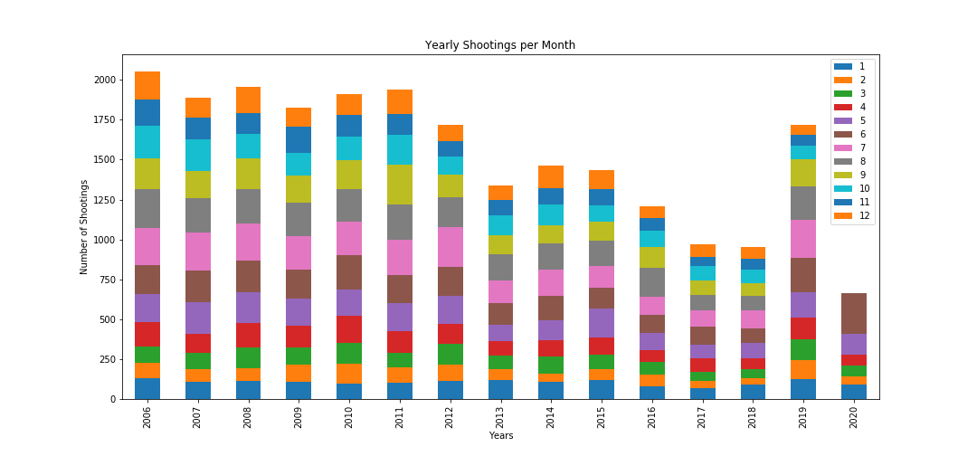
Data Exploration
Borough Breakdown – thought this would be more beneficial but not enough ties to methodology changes
Precincts too granular to benefit overall assumptions
Reviewed by year/ month/ time of day – all too granular for ultimate questions

Slide 9
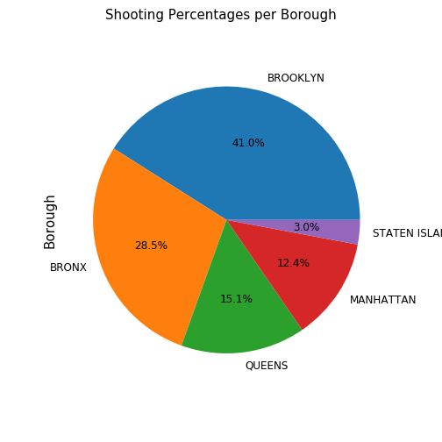
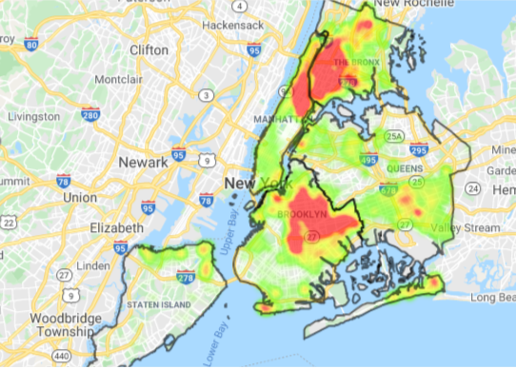
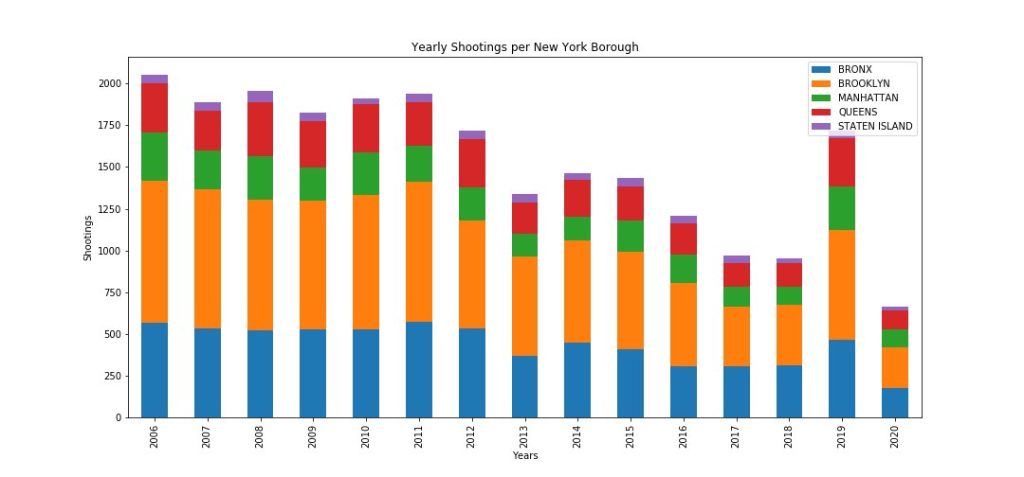
Most Dangerous Borough All Years by Shooting Count
Brooklyn
Bronx
Queens
Manhattan
Staten Island

Slide 10
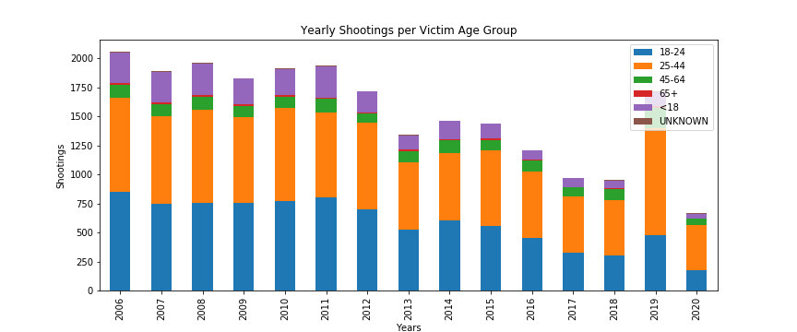
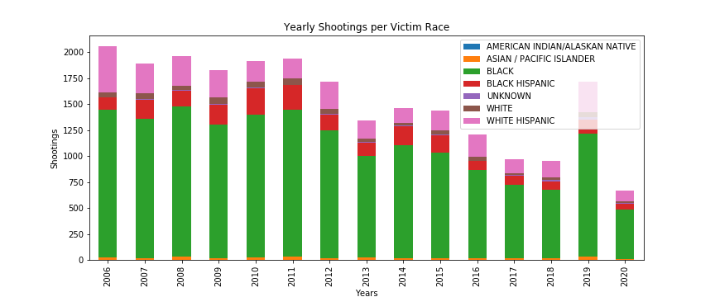
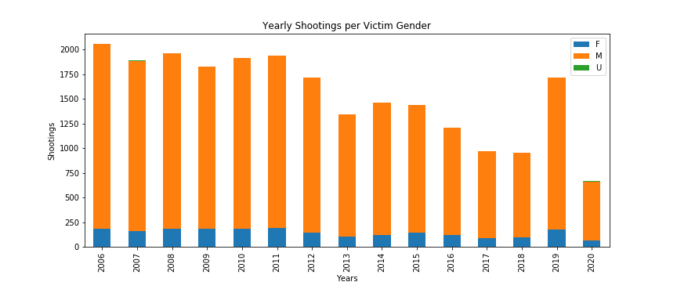
Victims Demographic Details

Slide 11
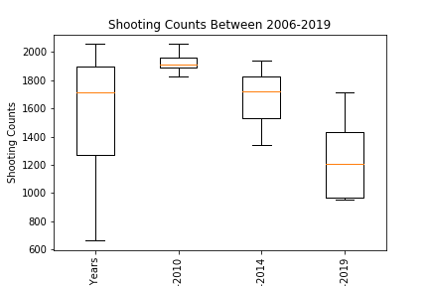
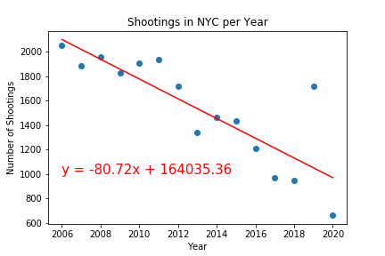
Do policing strategies help?

Slide 12
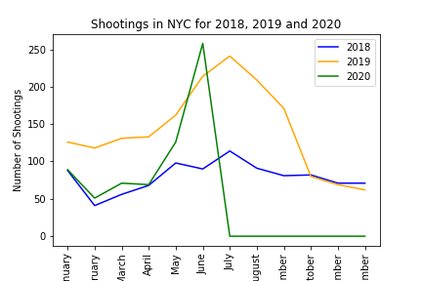
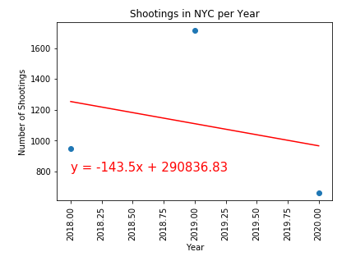
2019 change? Is this an outlier or indication of future trends

Slide 13
Significance?
P-Value 2014 vs 2018 = 0.79
Conclusion – not significant. As likely to see this drop in shooting rates due to chance.
P-Value 2018 vs 2019 = 0.61
Conclusion – not significant. Trending the wrong direction but not able to draw a correlation better than random chance.

Slide 14
Conclusion
While there does seem to be evidence indicating community and neighborhood led policing initiatives lead to a decrease in shootings, we were unable to draw conclusive evidence to support our alternate hypothesis.

Slide 15
Post Mortem
Many policing strategies are in play at one time – unable to clearly assume change over time or specific impacts
We only reviewed shooting data and not all crime – some strategies may be more effective for some types of crime. Would like to see overall crime rates and break down specifics for true impact analysis
No data for us to evaluate policing methodologies by police precinct or borough
Impact of current events

Slide 16
Data Sources
Borough Map: https://data.cityofnewyork.us/City-Government/Borough-Boundaries/tqmj-j8zm
Historic Shooting Data (2006-2019): https://data.cityofnewyork.us/Public-Safety/NYPD-Shooting-Incident-Data-Historic-/833y-fsy8
Year to Date Shooting Data (2020): https://data.cityofnewyork.us/Public-Safety/NYPD-Shooting-Incident-Data-Year-To-Date-/5ucz-vwe8
Research Articles for method years:
http://johnjay.jjay.cuny.edu/files/White.pdf
https://www1.nyc.gov/site/nypd/index.page

Slide 17

Questions?
This Photo by Unknown Author is licensed under CC BY

